Slide 1

Recent American History
Wojciech Krakowiak; Ilaryon Korneu 3Aj
Źródło: vecteezy.com

Slide 2
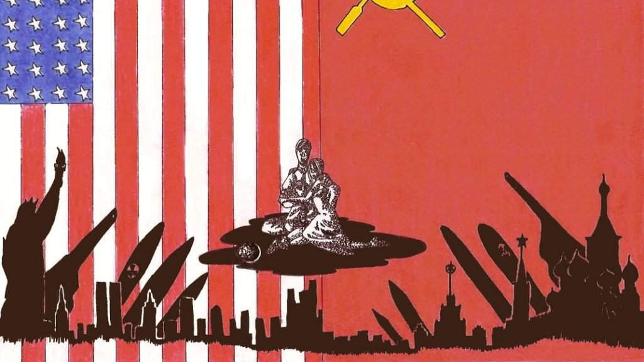
How did the Cold War start
It began with a disagreement between western powers and the USSR during Yalta and Potsdam Conferences
Stalin led USSR installed communist governments in eastern European countries
The US offered military and financial aid for countries that were under threat of communism
The Berlin Blockade (1948–1949) – The USSR blocked land access to West Berlin. The Western Allies responded with the Berlin Airlift, supplying the city by air until the blockade ended
After that both the western and eastern side formed alliances (NATO and Warsaw Pact)
Źródło: shuddhashar.com

Slide 3
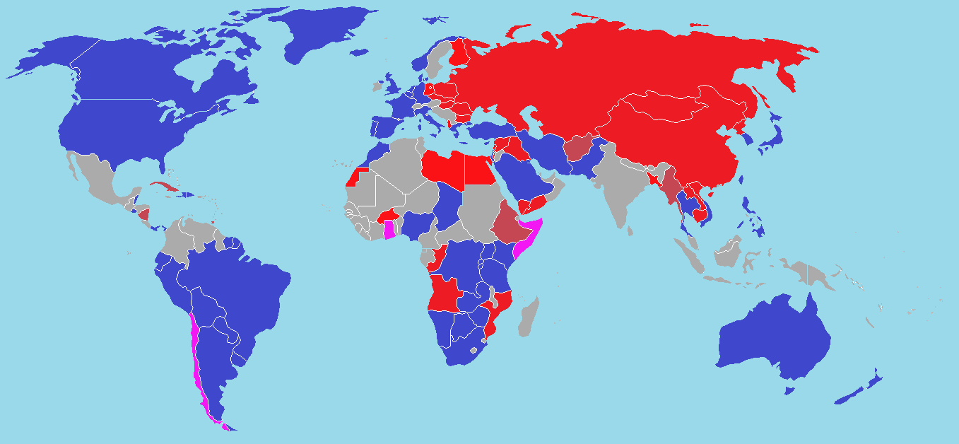

Western and Eastern Bloc
Źródło: fandom.com
The iron curtain divided Europe into two separate block
The western bloc was more liberal and richer compared to it’s eastern counterpart
Both sides of the silent conflict were in possession of nuclear weapons
Źródło: imgur.com

Slide 4

Arms Race
As long as two sides existed they were on the verge of a nuclear war
Some of the most advanced pieces of military equipment developed during this period are:
  Lockheed SR-71 Blackbird
  Lockheed F-117 Nighthawk
  Radar Duga
  KH-9 HEXAGON
This arms race has come to an end after the collapse of the Soviet Union in 1991
Źródło: boardgamegeek.com

Slide 5
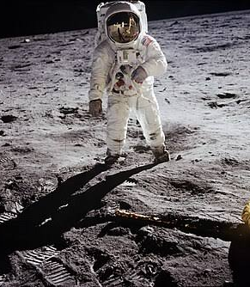
Space Race and the Moon Landing
Technological race with the USSR as part of the Cold War
USSR sends the first person to space (1961)
The US sends the Apollo 11 mission to the Moon in 1969
Neil Armstrong
Buzz Aldrin
Michael Collins
"One small step for man, one giant leap for mankind" - Neil Armstrong, 1969
Źródło: en.wikipedia.org

Slide 6
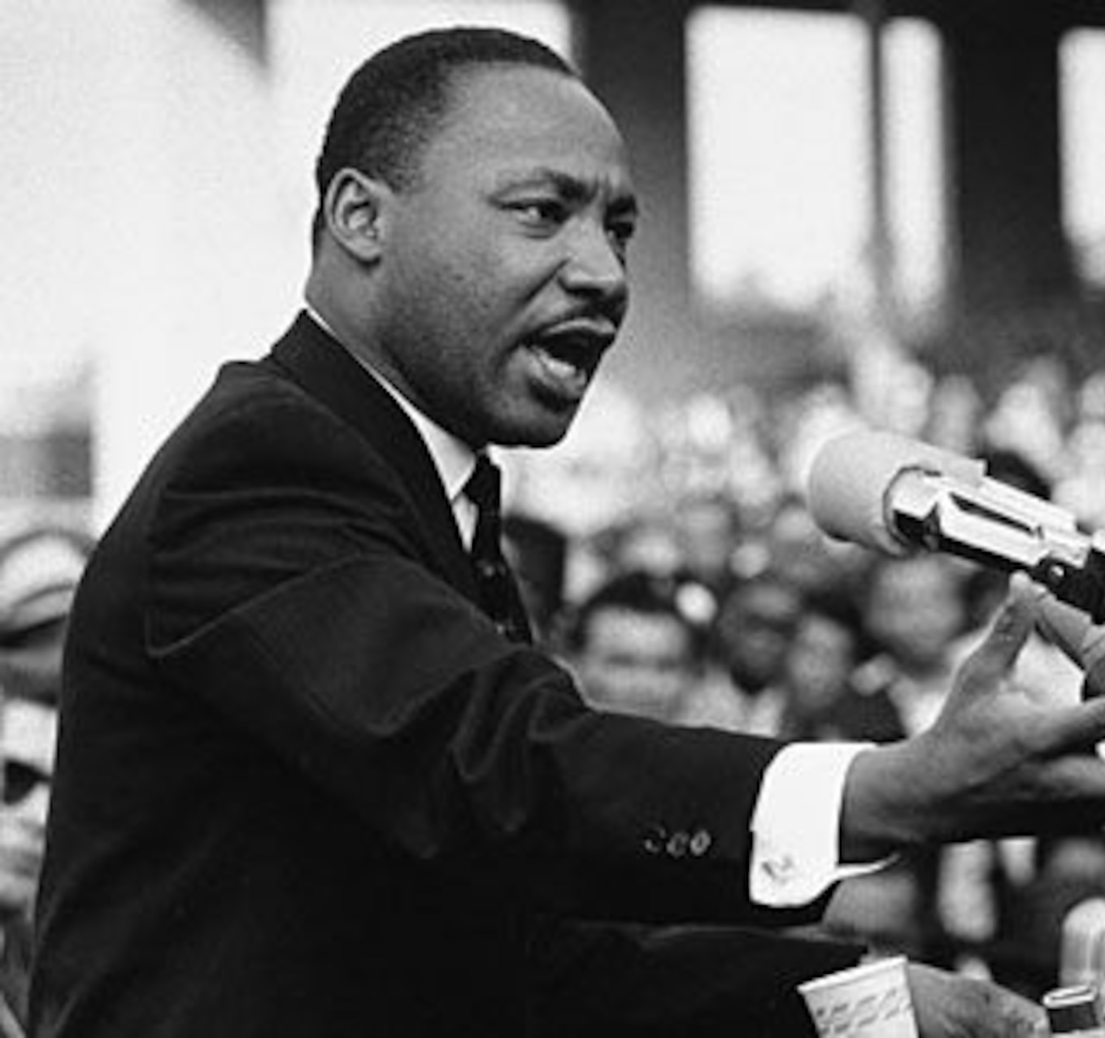
Civil Rights Movement
Opposition of the "Jim Crow Laws"
Abolishing Racial Segregation
Disenfranchisement – restriction of voting rights for certain groups of people
Martin Luther King Jr.
Rosa Parks – Montgomery Bus Boycott
Greensbury Sit-Ins and the Sit-In movement
Led to the Civil Rights Act of 1968
"I have a dream... " - Martin Luther King Jr., 1963
Źródło: www.vance.af.mil

